Slide 1
Assignment 3 FACEBOOK COMMENT ANALYSIS
Team 5
Akash Jagtap
Jerin Rajan
Nitin Prince Reuben

Slide 2
Overview
GOAL
1
EDA
2
FEATURE ENGINEERING
3
ALGORITHMS
4
FEATURE SELECTION
5
MODEL VALIDATION
6
DEMO
7

Slide 3

GOAL
To find number of comment in give base time depending upon factors like: number of like and share for the post, length of post, when was it posted, etc.

Slide 4

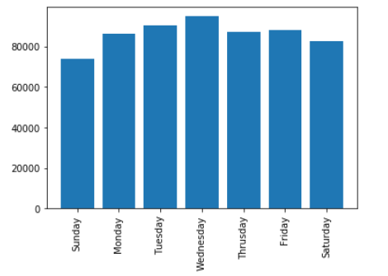
Exploratory Data Analysis

Slide 5
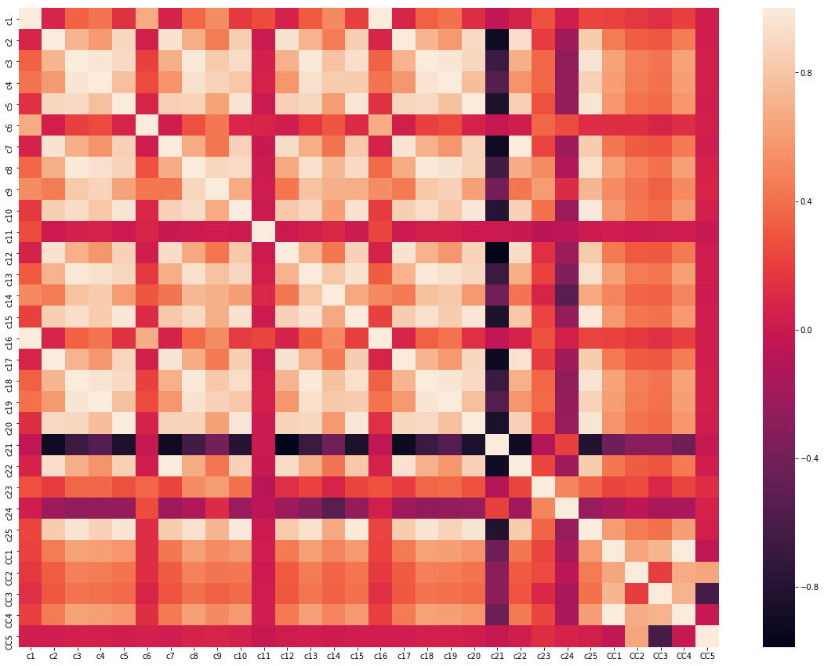

Slide 6
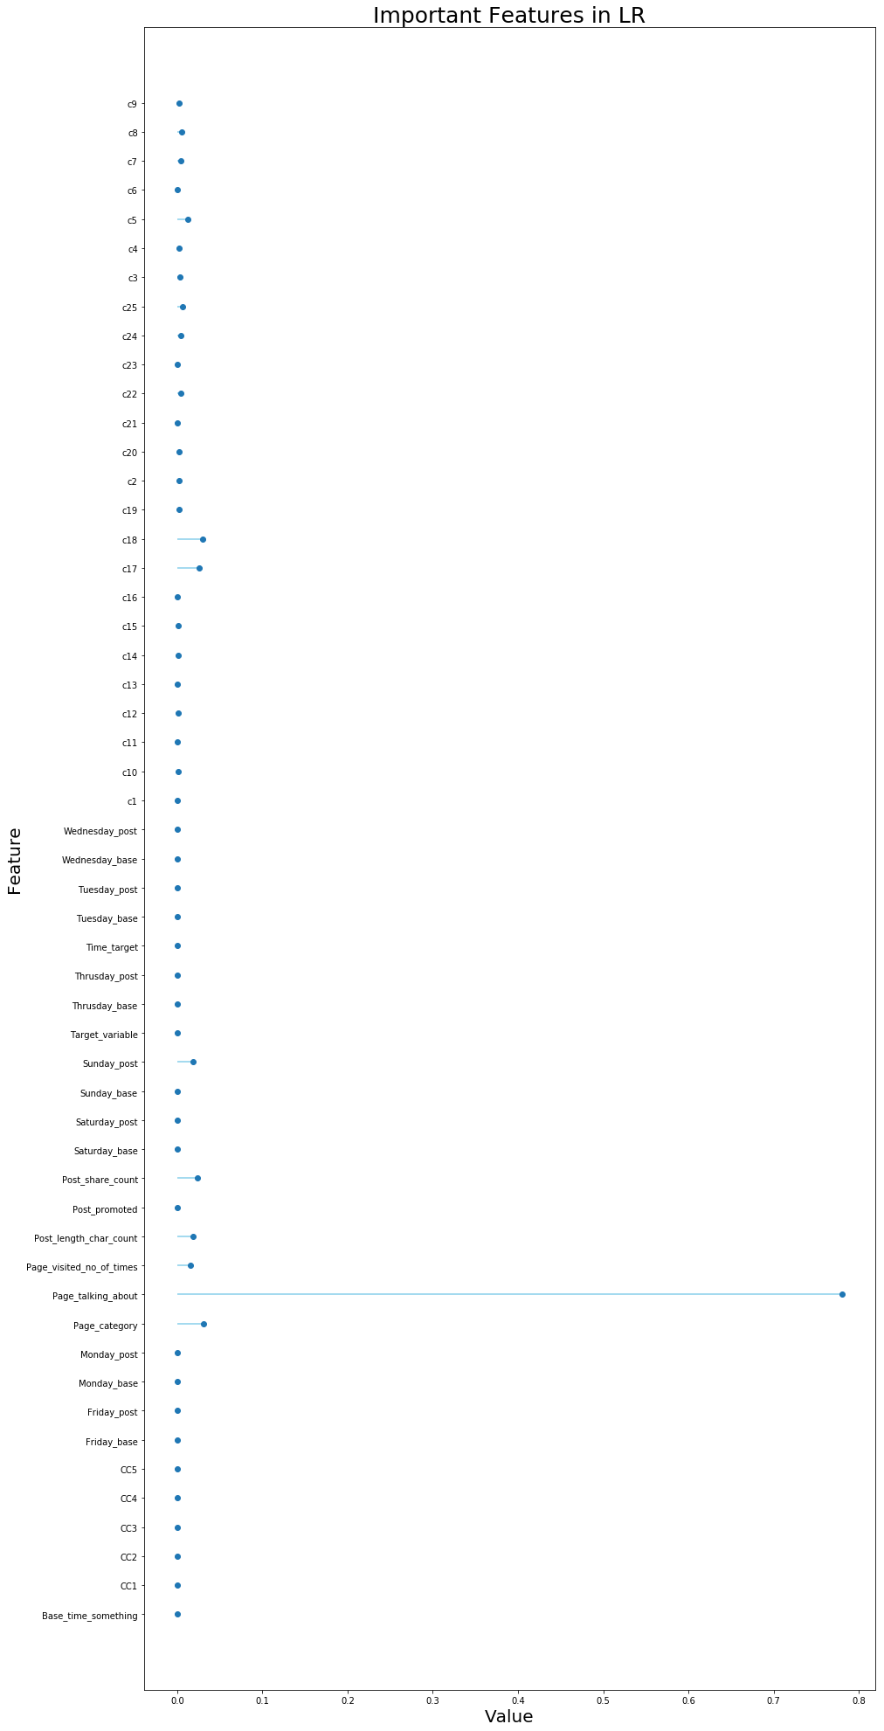
Feature Engineering

Slide 7
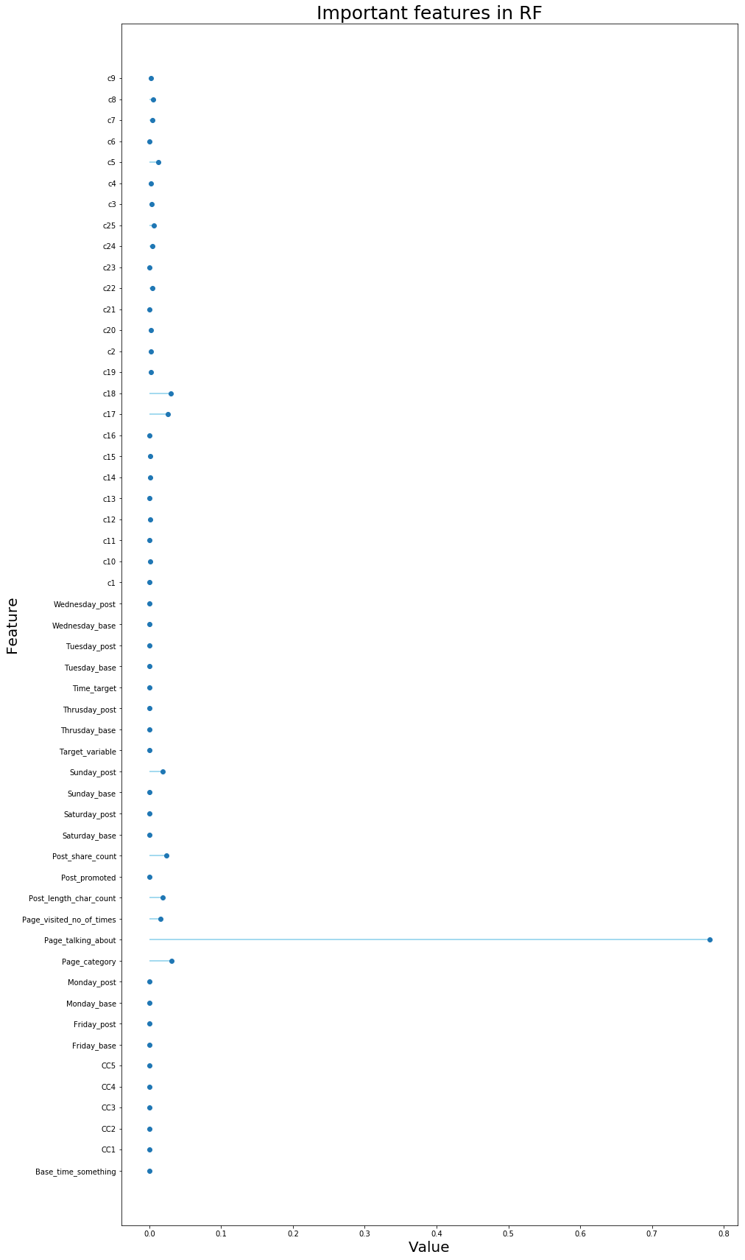

Slide 8
Algorithm
Linear Regressor
Random Forest
K-nearest Neighbor
Support Vector Regressor
Neural Network

Slide 9
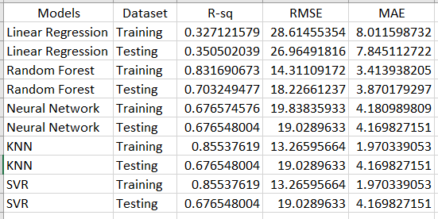

Slide 10
Feature Selection
Boruta
RFSEC

Slide 11
Model Validation
Cross-validation
01
Bias-variance tradeoff
02
Regularization
03

Slide 12
DEMO

Slide 13
Thankyou

